Slide 1
Smart Waste Management System for Metropolitan Cities PNT2022TMID33826 SPRINT-III MIT APP

Slide 2
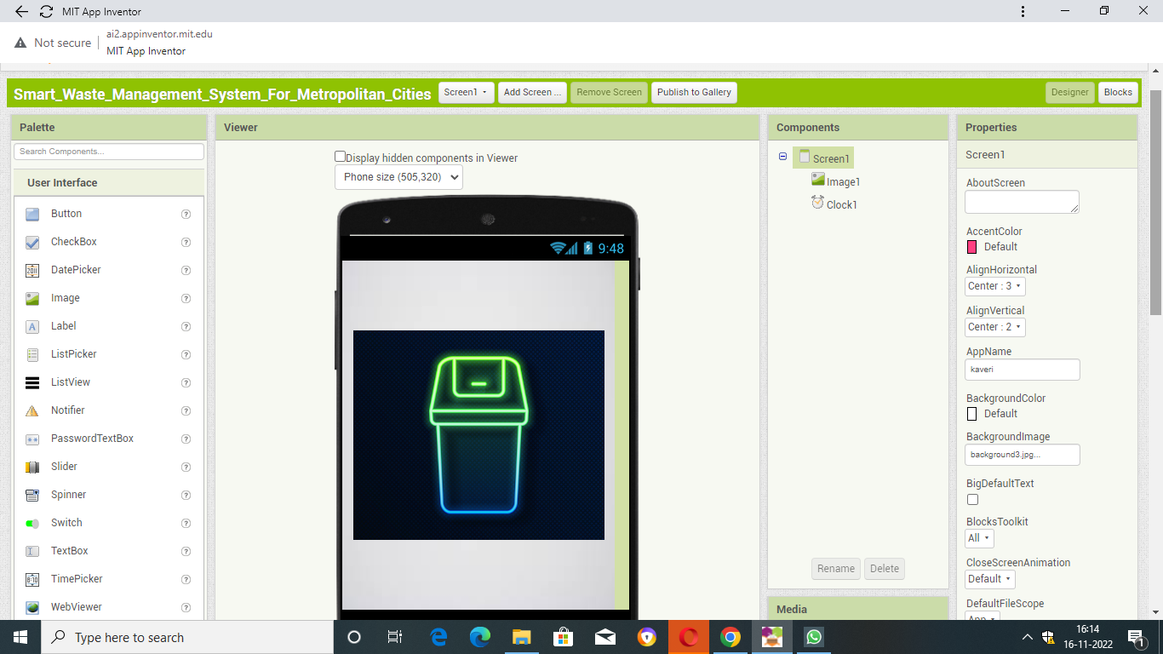
SCREEN 1- FRONT END OF DEVELOPEMENT OF OPEN SCREEN

Slide 3
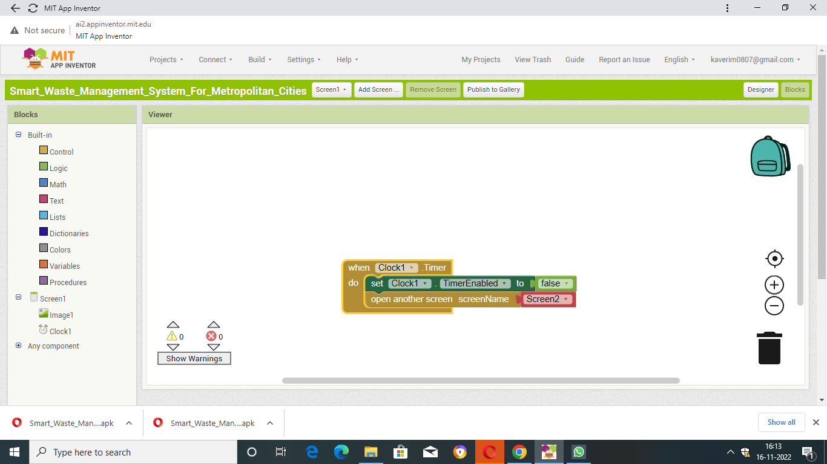
BACK END DEVELOPMENT OF OPEN SCREEN

Slide 4
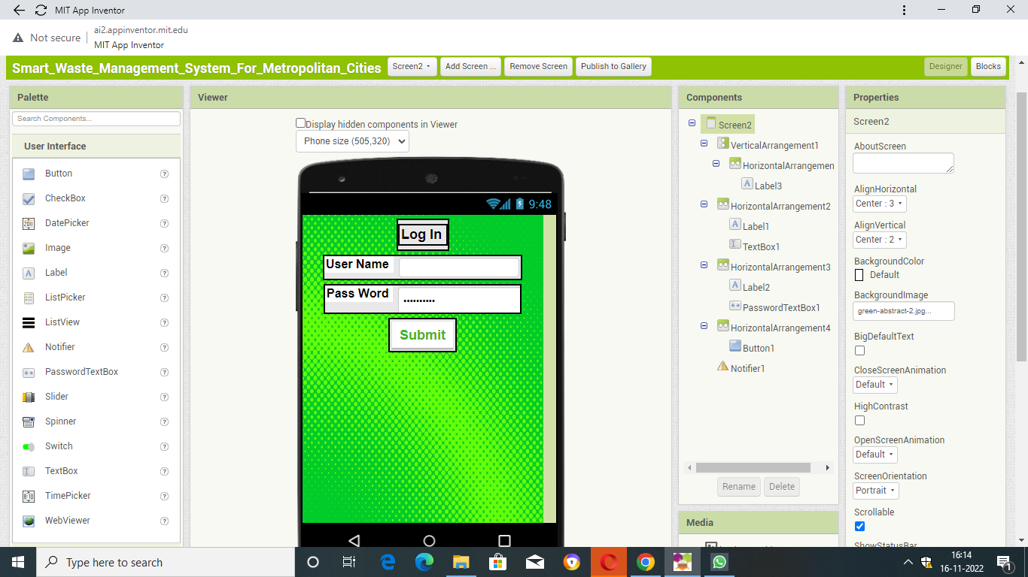
FRONT END DEVELOPMENT OF LOG IN PAGE

Slide 5
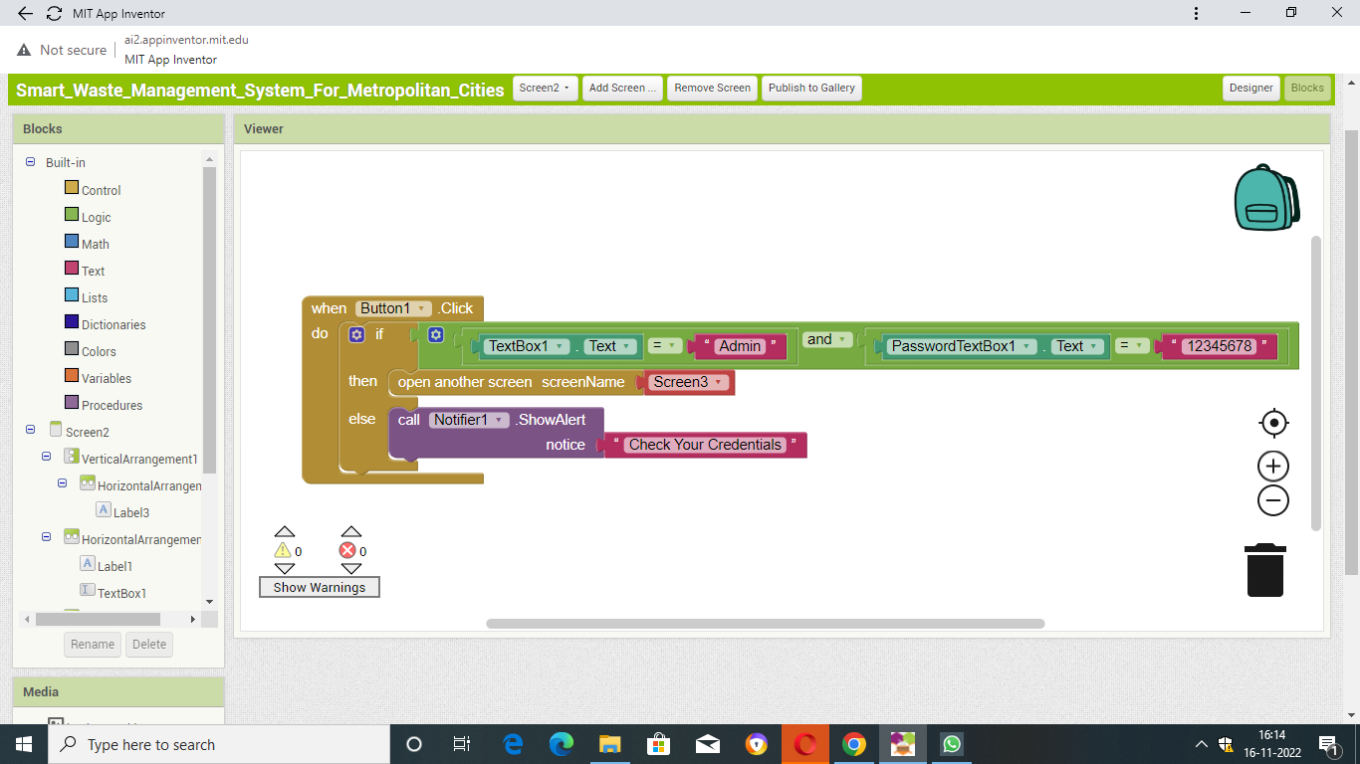
BACK END DEVELOPMENT OF LOGIN PAGE

Slide 6
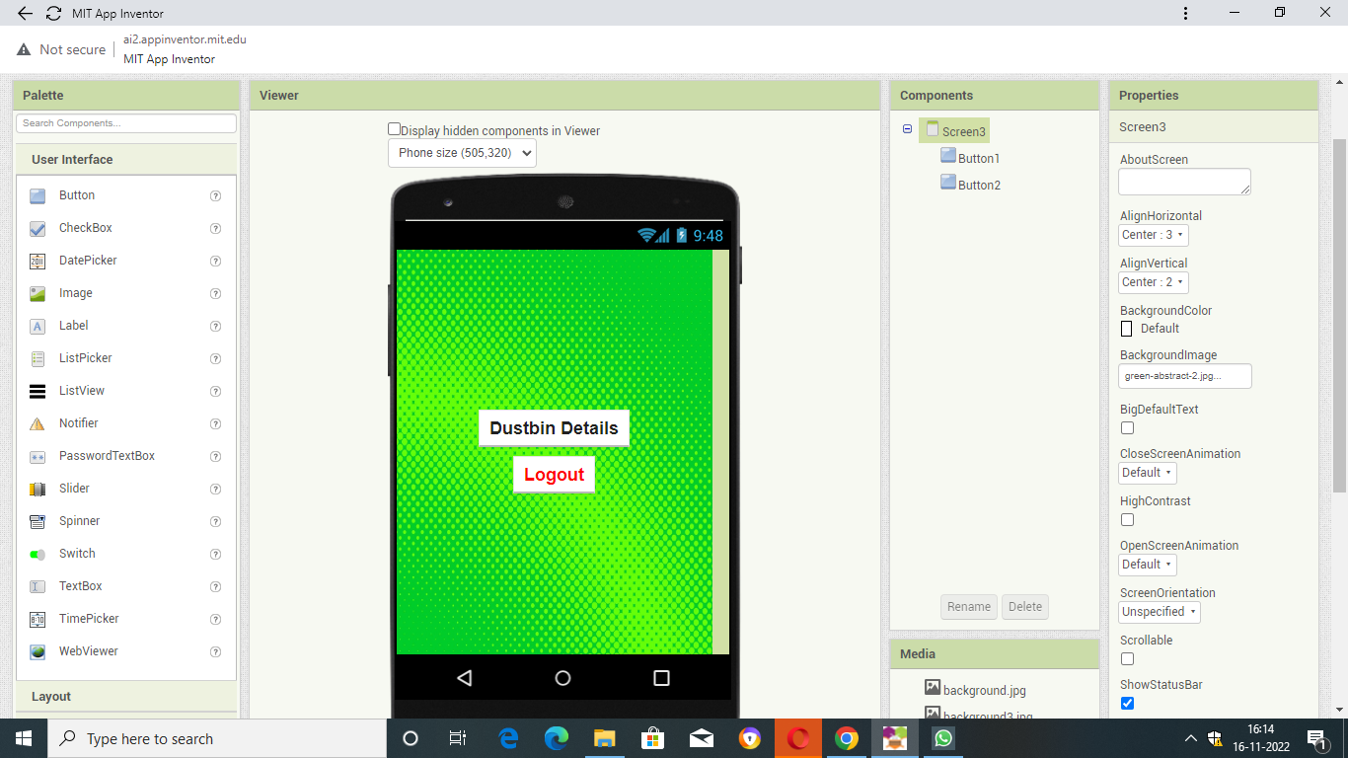
FRONT END OF GARBAGE DELAILS PAGE

Slide 7
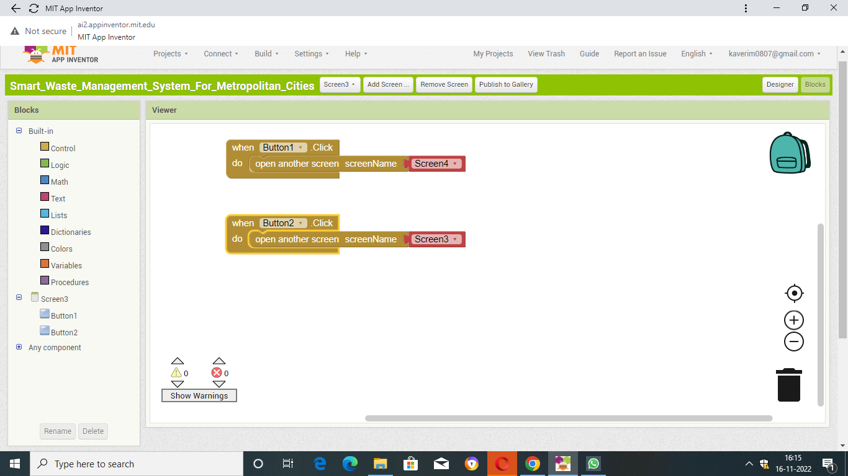
BACKEND DEVELOPMENT OF GARBAGE DETAILS PAGE

Slide 8
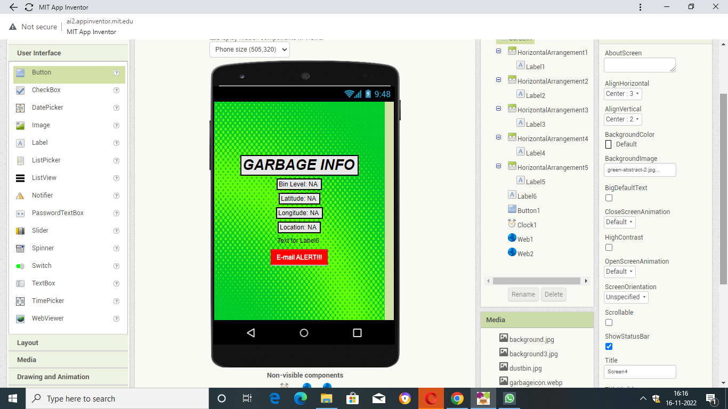
FRONT END OF GARBAGE INFO PAGE LINKED TO WEB PAGE

Slide 9
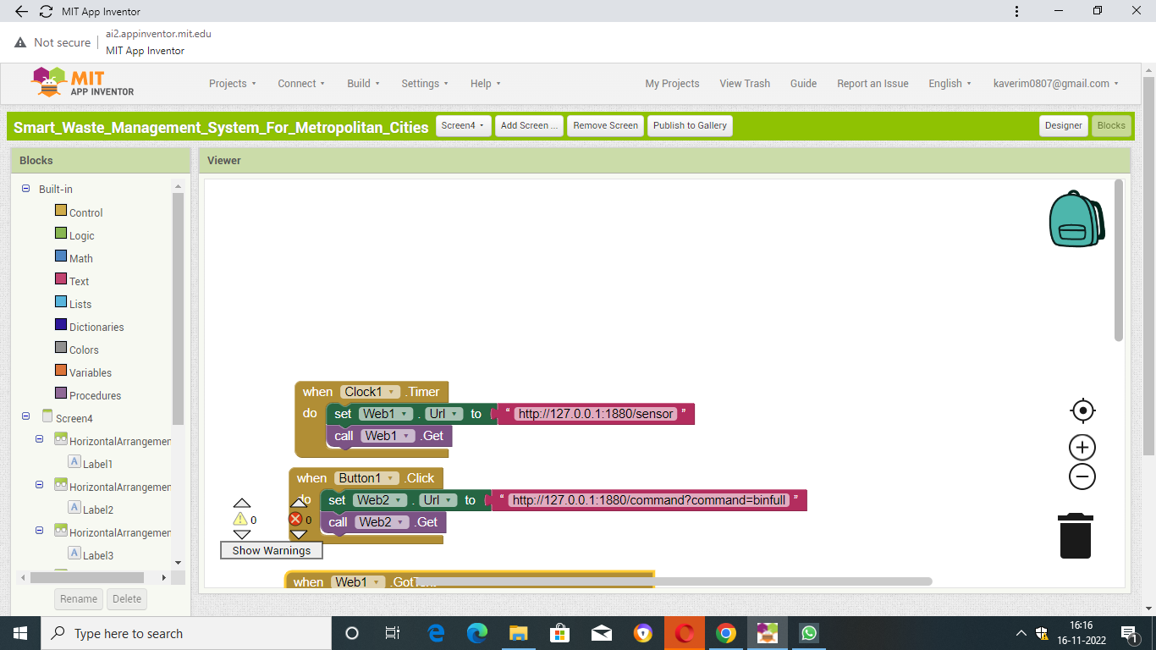
BACK END OF GARBAGE INFO PAGE LINKED TO WEB PAGE

Slide 10
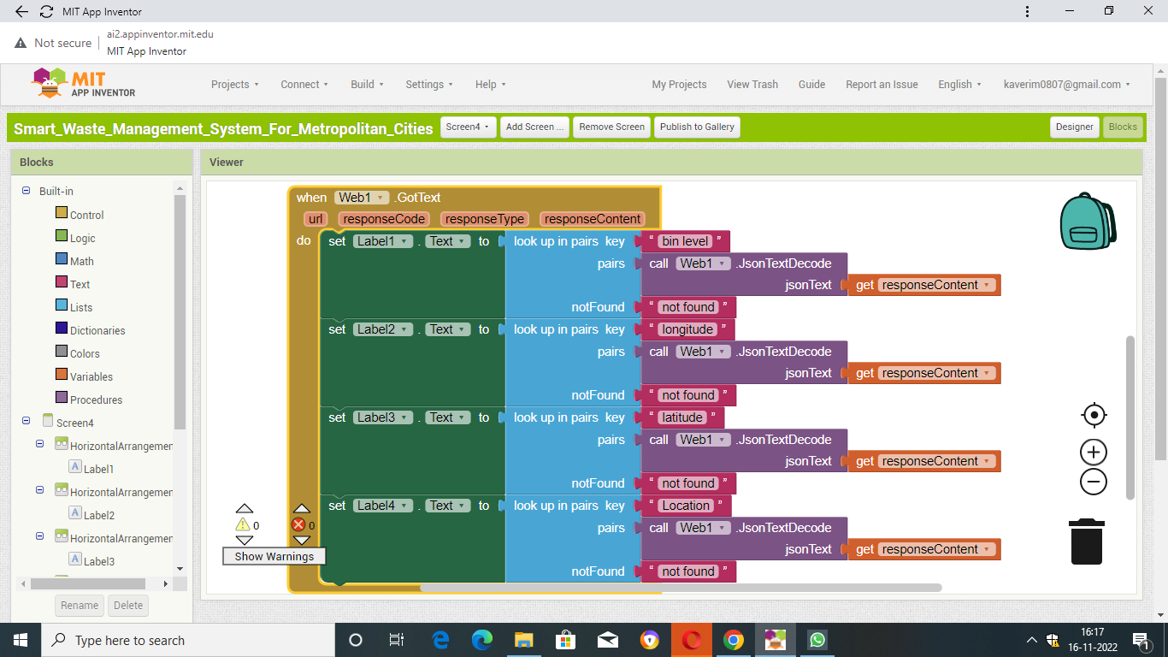
BACK END OF GARBAGE INFO PAGE LINKED TO WEB PAGE

